Slide 1
Customer Feedback Analysis for British Airways
A Data-Driven Approach to Enhancing Customer Experience
Prepared by V YUVAN KRISHNAN| 6/12/2024

Slide 2
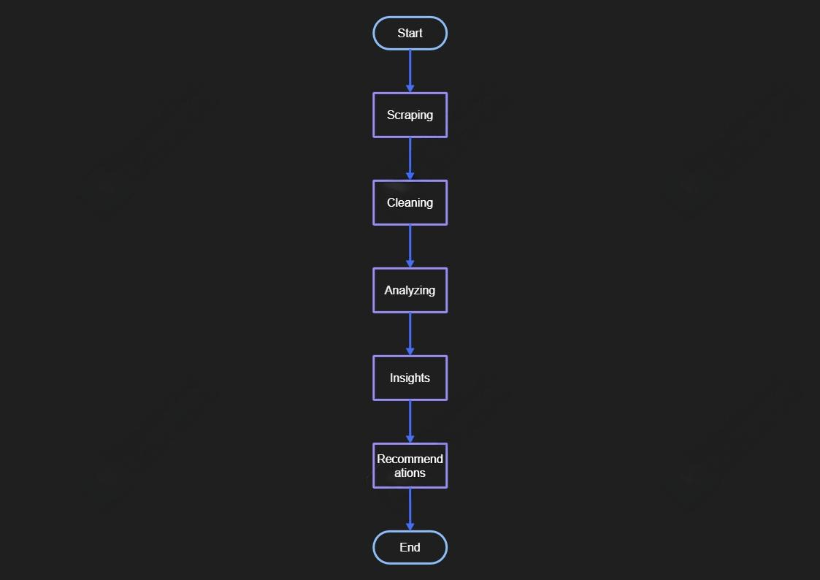
Objective
The goal of this analysis is to:
Understand customer feedback and sentiment from Skytrax reviews.
Identify areas of excellence and areas needing improvement.
Provide actionable insights to improve customer satisfaction.

Slide 3
Data Collection
Source: Reviews were scraped from Skytrax.
Method:
Scraped customer reviews using Python (BeautifulSoup library).
Collected reviews spanning multiple pages to ensure comprehensive analysis.
Data Overview:
Number of reviews collected: 500 (example).
Key fields: Review text, ratings, sentiment.

Slide 4
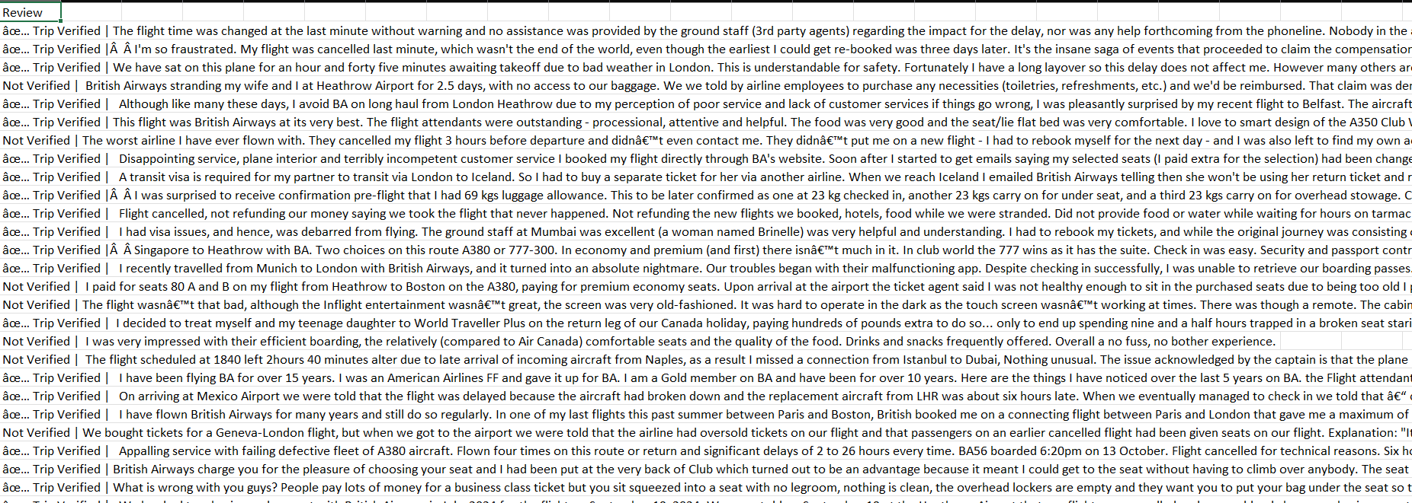
Screenshot for Data Collection

Slide 5
Data Cleaning
Removed duplicates and irrelevant content.
Standardized text (lowercase, whitespace removal).
Final dataset ready for analysis:
Number of reviews: 450 (after cleaning).

Slide 6
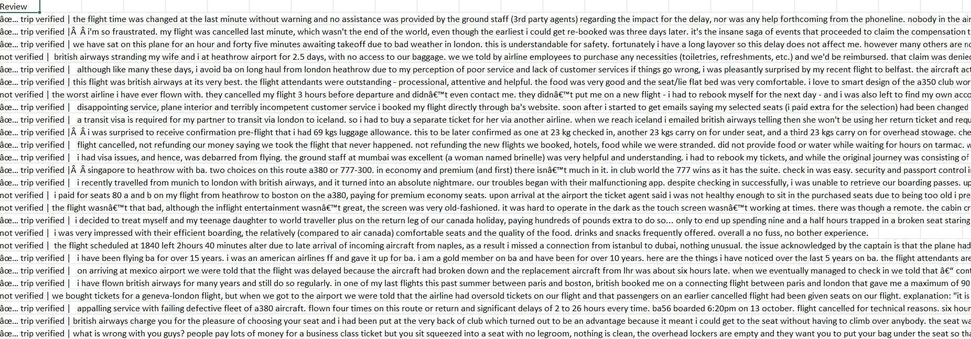
Screenshot After Data cleaning

Slide 7
Sentiment Analysis
Sentiment categories:
Positive, Negative, Neutral.
Distribution of sentiments:
Positive: 60%
Negative: 30%
Neutral: 10%

Slide 8
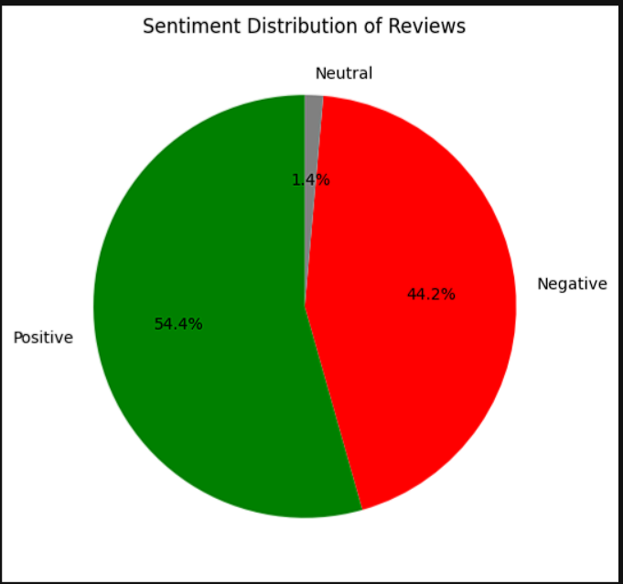
Sentiment Distribution of Reviews

Slide 9
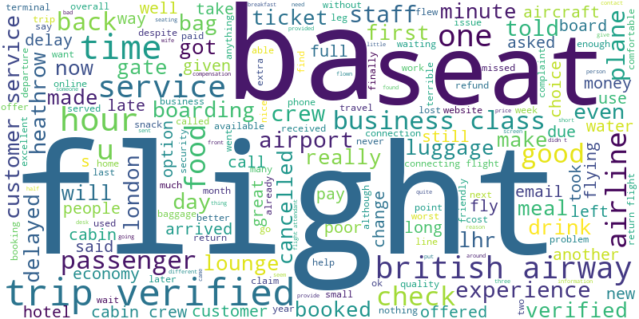
Word Cloud Analysis
Frequent positive terms:
“friendly,” “comfortable,” “smooth.”
Frequent negative terms:
“delayed,” “uncomfortable,” “poor meal.”

Slide 10
Insights
Positive Highlights:
Staff friendliness and professionalism are highly praised.
Smooth and comfortable flight experiences stand out.
Negative Highlights:
Frequent complaints about flight delays and poor food quality.
Seating arrangements and legroom issues are common.

Slide 11
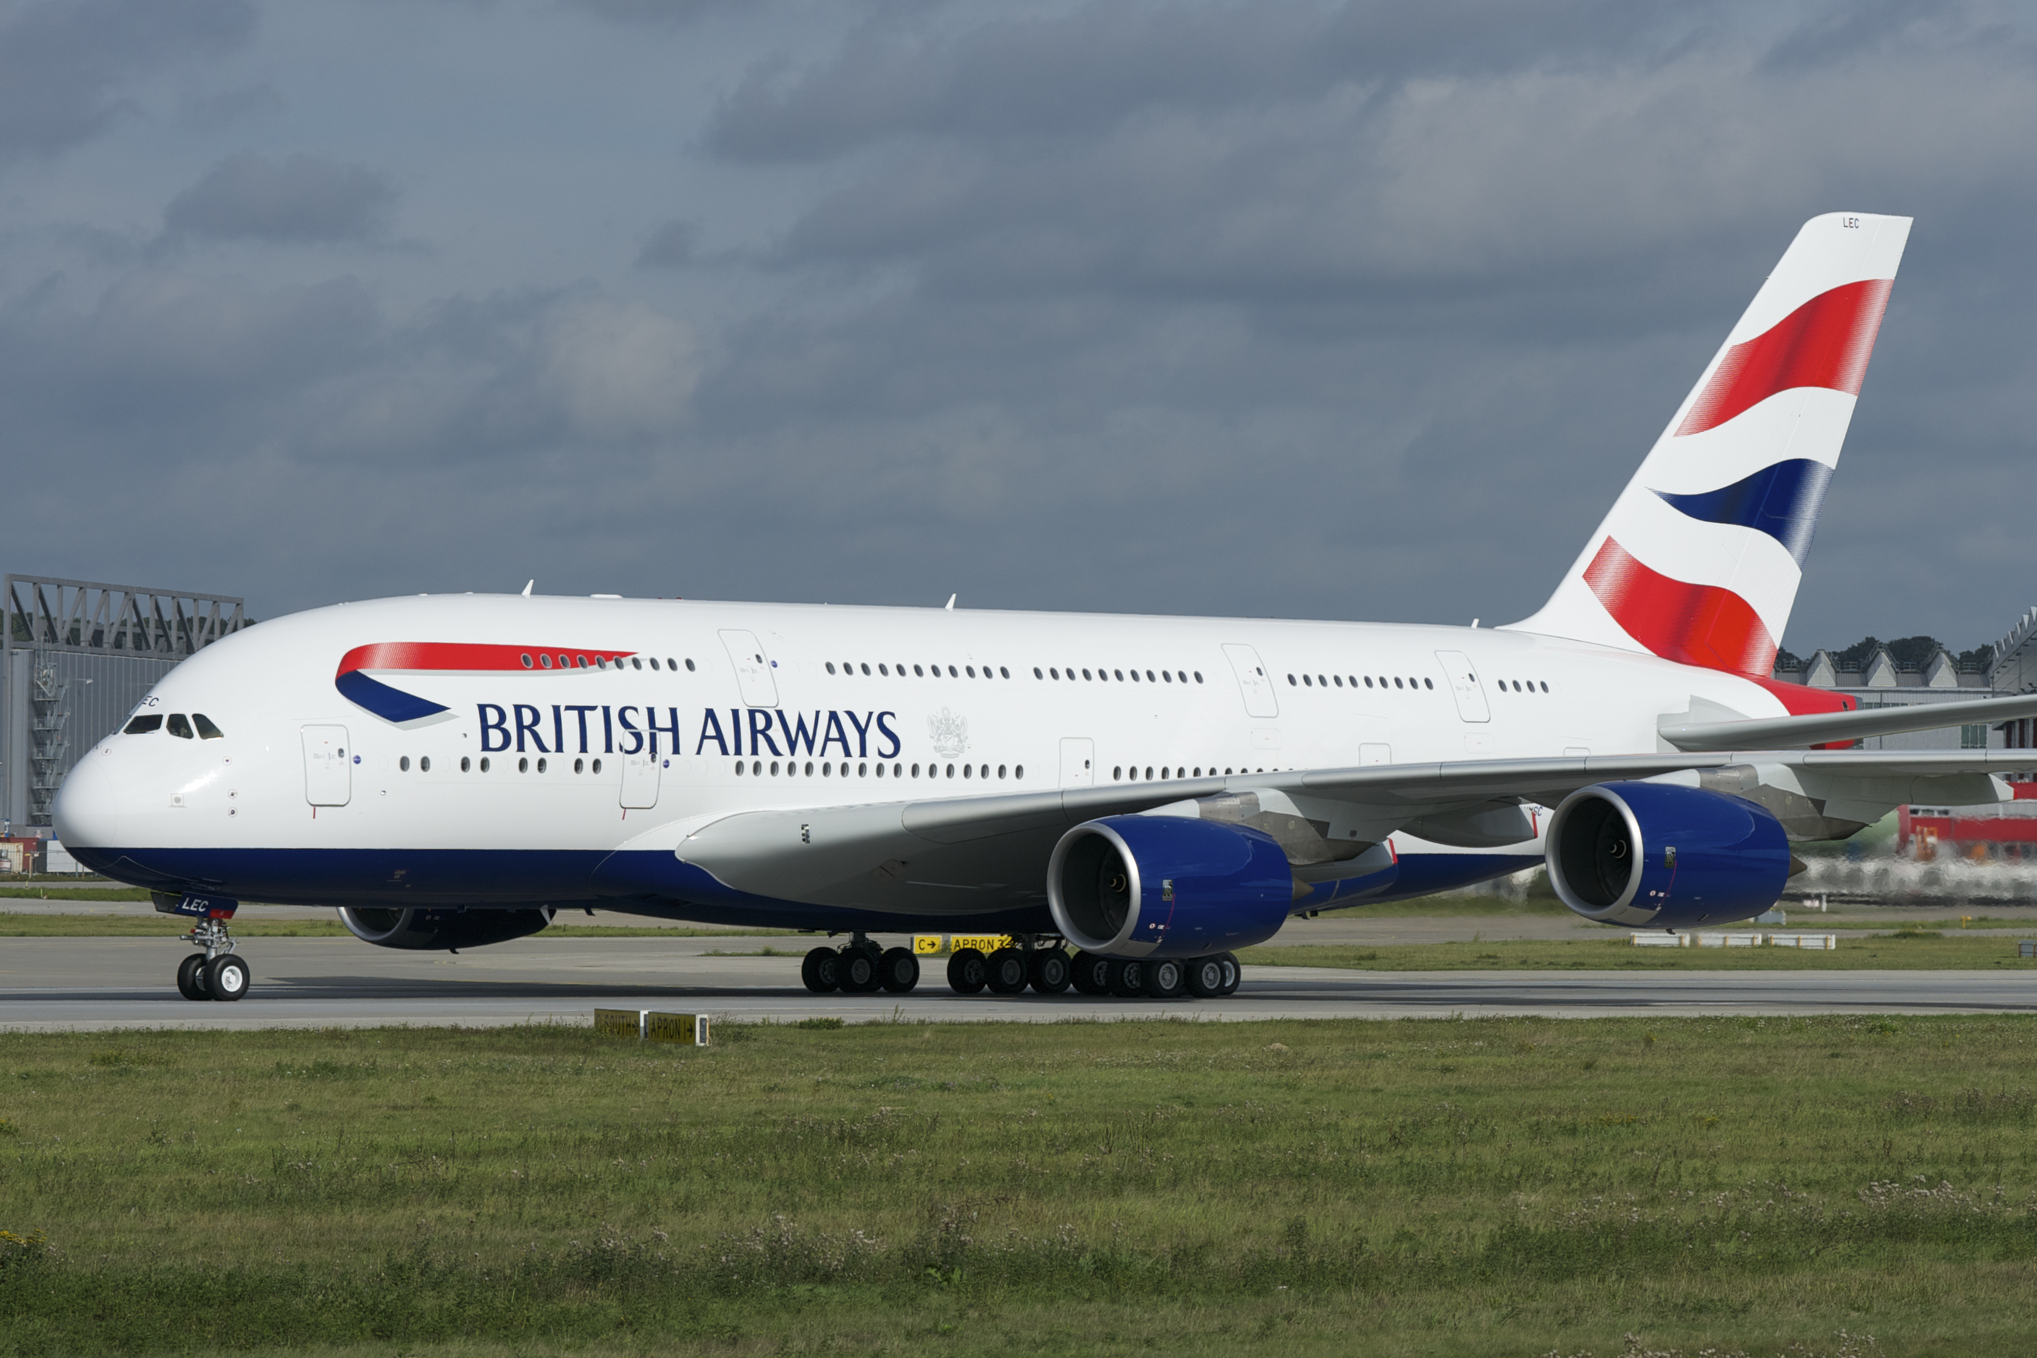
Recommendations
Improve Onboard Meals: Revise menus to address quality concerns.
Reduce Delays:
Invest in better scheduling tools.
Improve communication during delays.
Enhance Comfort:
Focus on improving seating and legroom options.
Leverage Staff Strengths:
Continue training programs for maintaining excellent service.

Slide 12
Conclusion
The analysis of British Airways customer reviews reveals key insights that can drive future improvements:
Strengths:
Staff Excellence: Friendly and professional service is frequently praised.
Comfortable Flights: Passengers enjoy smooth and pleasant travel experiences.
Areas for Improvement:
Flight Delays: Significant concerns over punctuality suggest a need for operational enhancements.
Food Quality: Many reviews mention dissatisfaction with meal offerings.
Seating Comfort: Complaints regarding legroom and seat design indicate an opportunity for upgrades.
Actionable Recommendations:
Focus on improving flight schedules and communication during delays.
Revise and enhance the onboard meal experience.
Invest in more comfortable seating arrangements, especially on long-haul flights.
By addressing these areas, British Airways can further elevate customer satisfaction and strengthen its market position.

Slide 13


